Slide 1
Swiggy Data Analysis Project
An end to end project understanding of customer behaviour, Order Trend, Delivery partner’s performance and Top rated Restaurant.

Slide 2
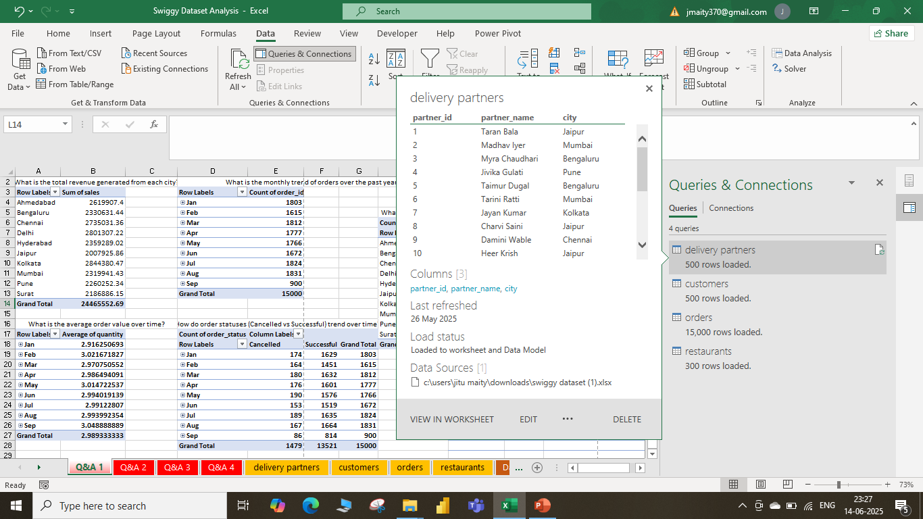
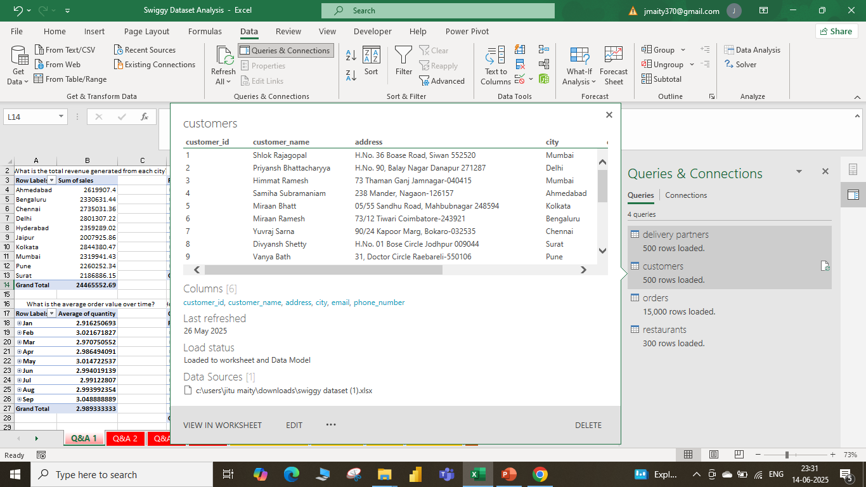
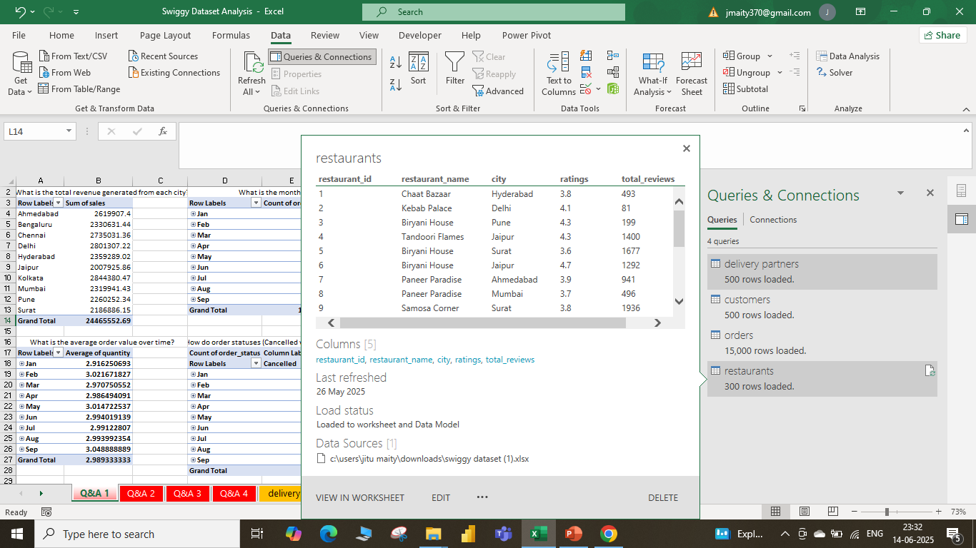
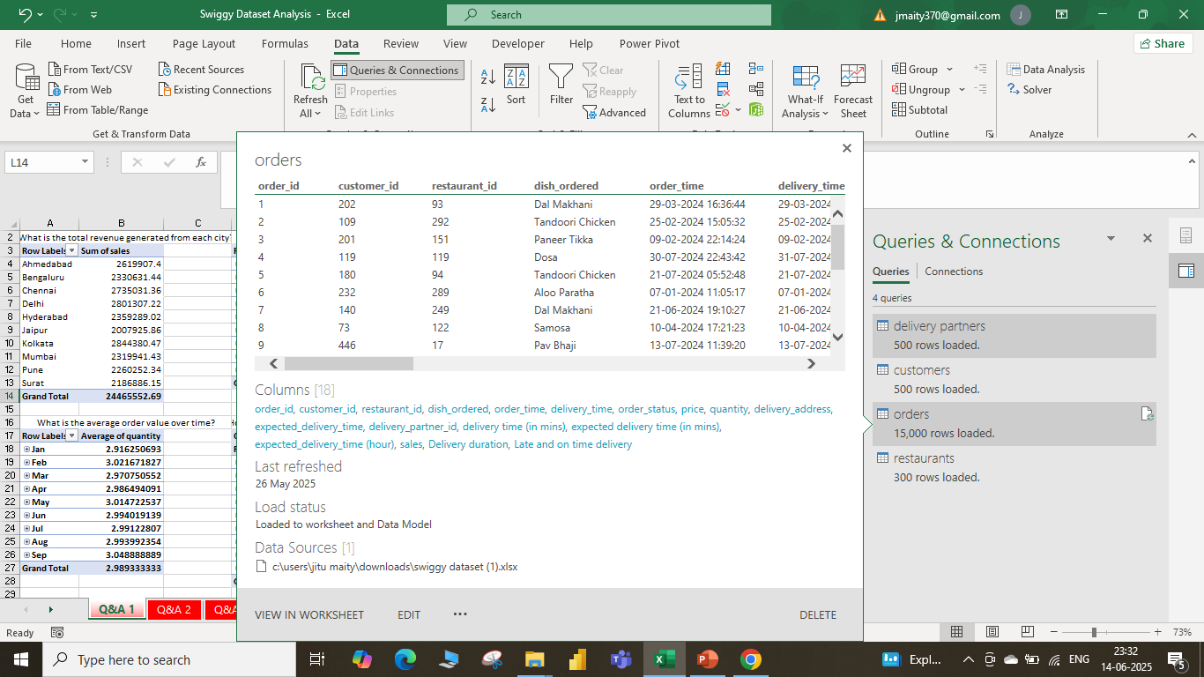
Dataset & Queries: Building connection

Slide 3
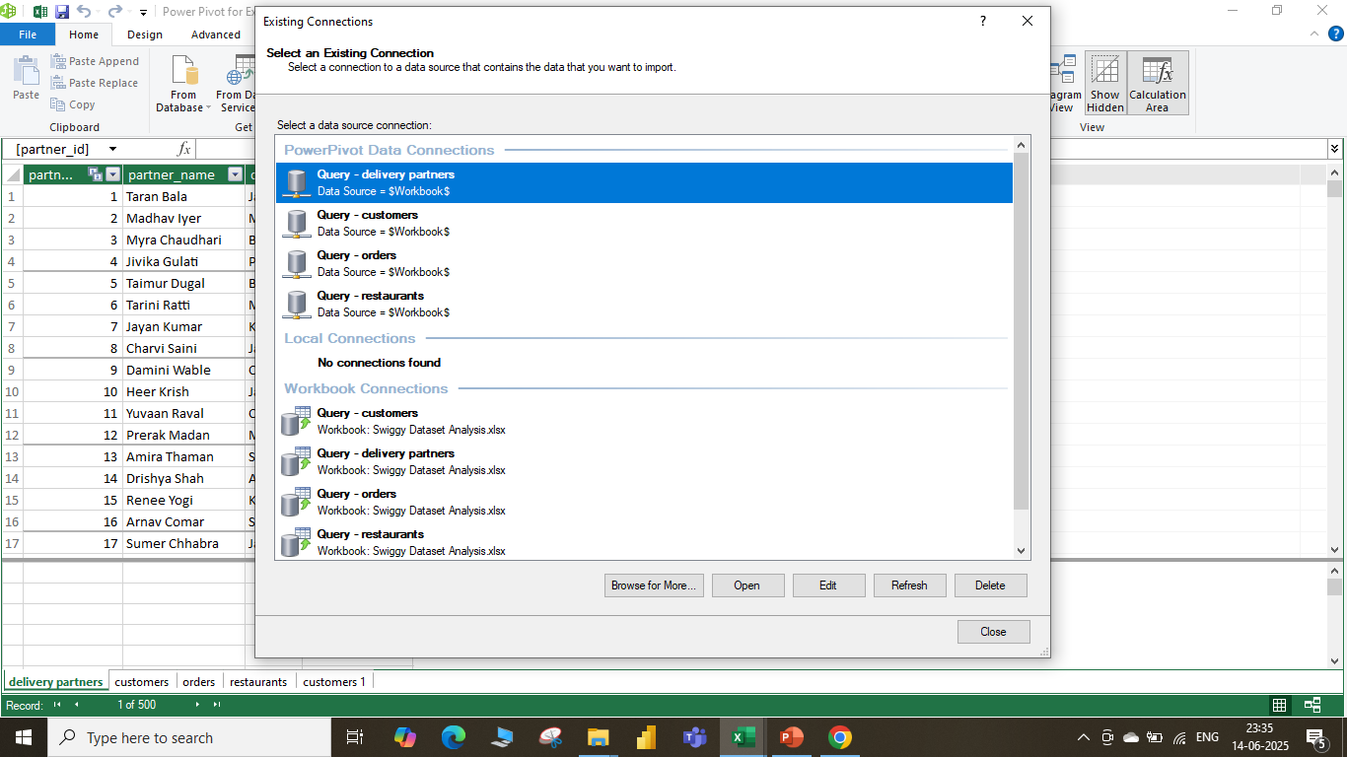
Relationship Building

Slide 4
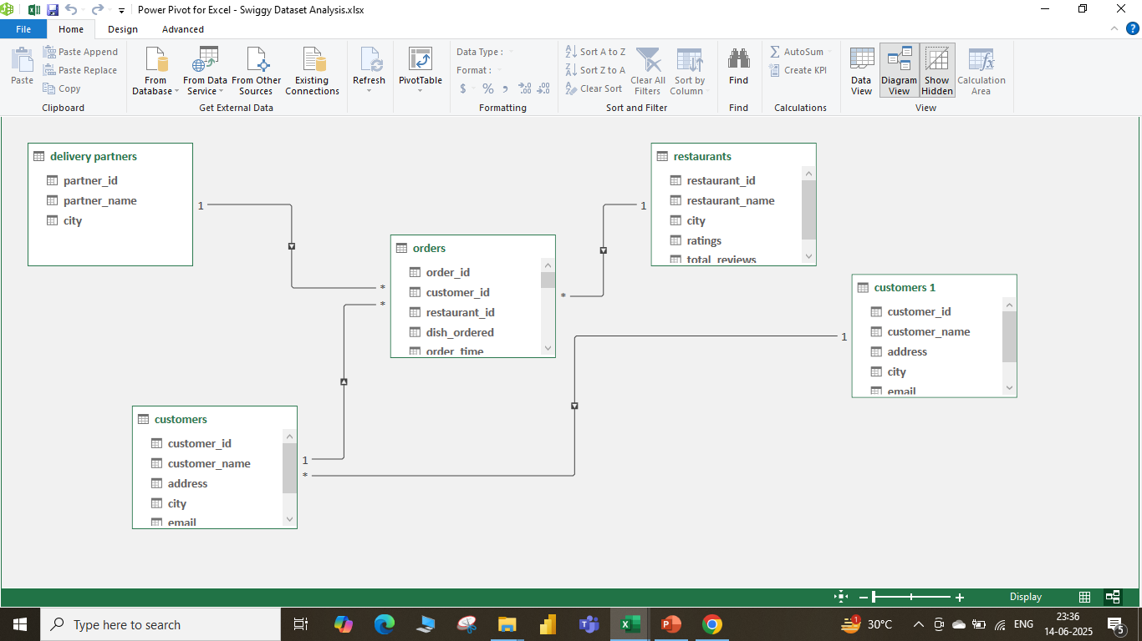

Slide 5
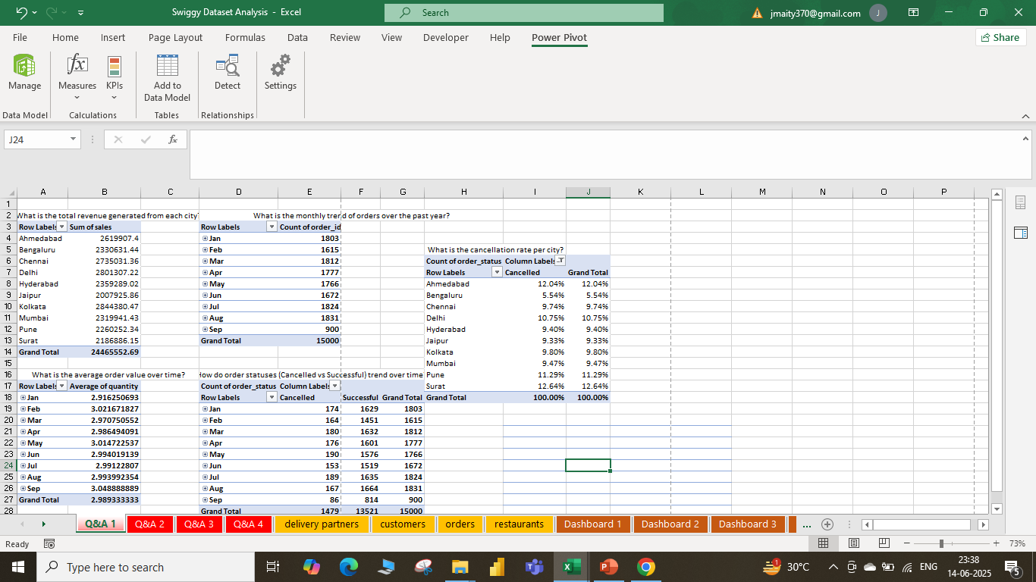
1. 📦 Order Trends & Revenue Insights Total Revenue by City: Top-earning city: Chennai with ₹27.35 lakh. Followed by Ahmedabad (₹26.19 lakh), and Delhi (₹24.96 lakh). The revenue distribution aligns closely with population density and urban food delivery adoption. Monthly Order Trend: Orders peaked in January and March, indicating a higher food delivery frequency during holidays and post-payday periods. Gradual monthly fluctuations suggest consistent consumer engagement across the year.

Slide 6
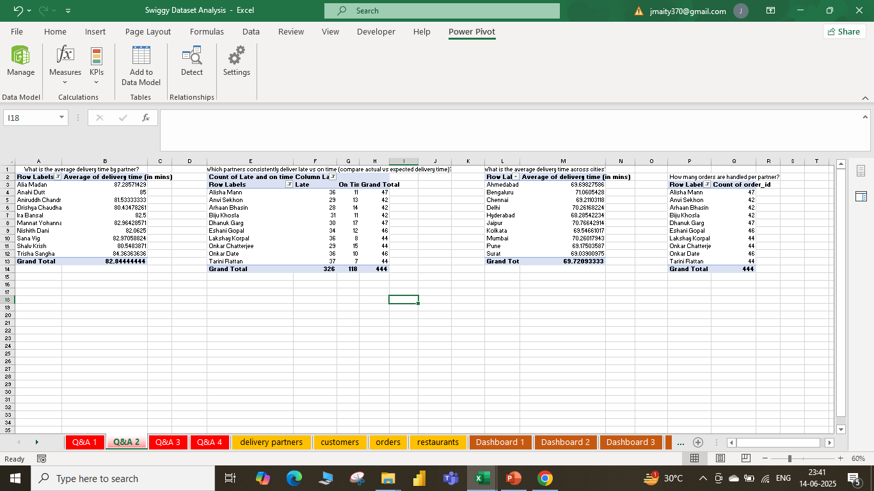
2. 🚴‍♂️ Delivery Partner Performance Average Delivery Time: Ranges from ~80 mins (Drishya Chaudhari) to ~87 mins (Alia Madan). Ahmedabad has the lowest average delivery time (69.7 mins), suggesting optimized delivery routing. Late vs On-Time Delivery: Partners like Alisha Mann had 36 late vs 11 on-time deliveries, performance concerns. An analytical model comparing expected vs actual delivery time was used to label each delivery. Orders Per Partner: High-performing partners manage up to 47 orders, highlighting capacity variations.

Slide 7
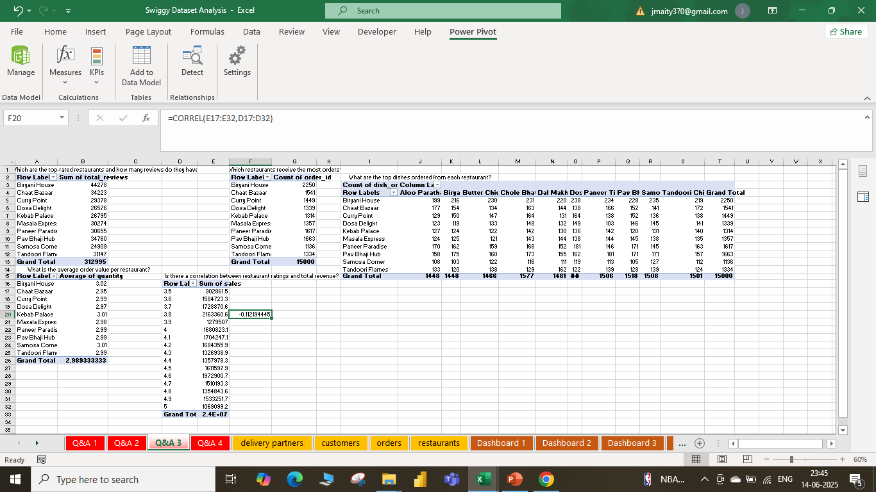
3. 🍽️ Restaurant Performance Analysis Top Rated Restaurants: Biryani House received the highest reviews (44,278) with a high average rating. Followed by Chaat Bazaar, Curry Point, and Dosa Delight. Most Ordered Restaurants: Biryani House again tops with 2,250 orders, indicating both popularity and high operational throughput. Most Popular Dishes: Cross-restaurant favorite dishes include: Aloo Paratha, Butter Chicken, Paneer Tikka, Biryani

Slide 8
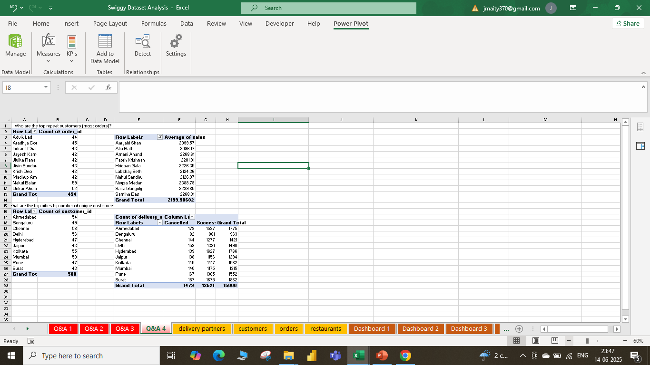
🙋‍♂️ Customer Behavior Insights Top Repeat Customers: Aradhya Comar (45 orders), Advik Lad (44 orders), and Indranil Chandra (43 orders) lead as most loyal users. High-Value Customers: Amani Anand has the highest average order value (~₹2,269), useful for loyalty and premium targeting.

Slide 9
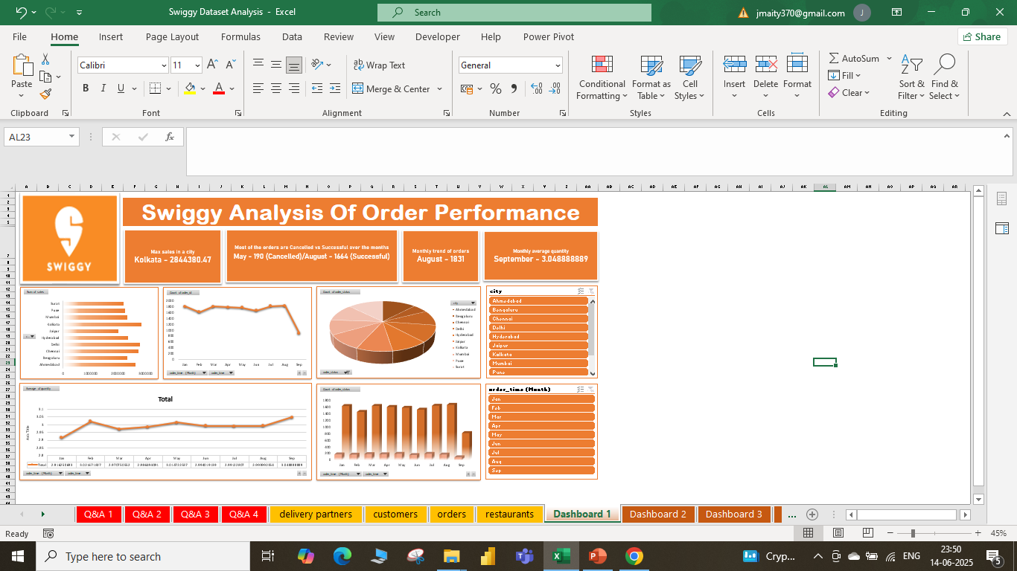
📈 Dashboard Highlights (Interactive Views)

Slide 10
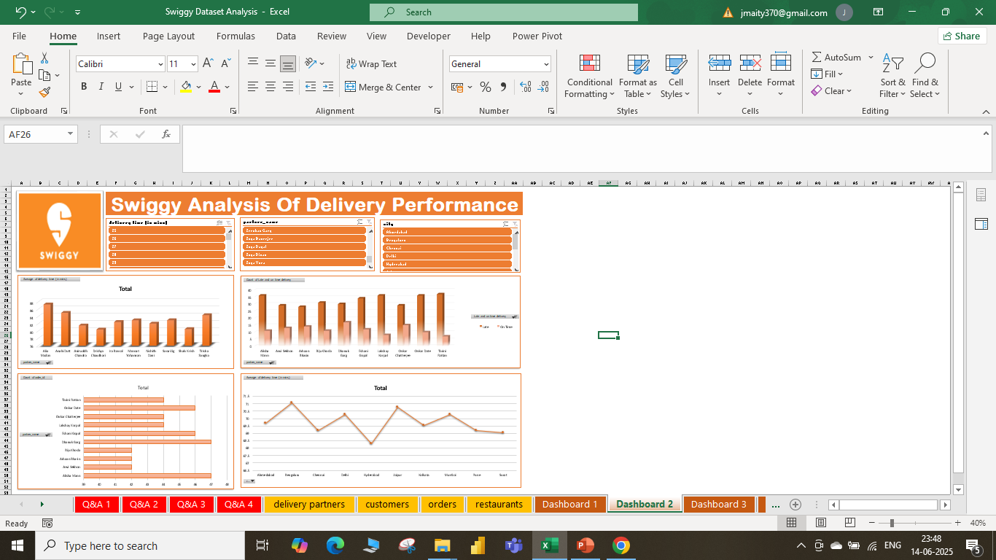

Slide 11
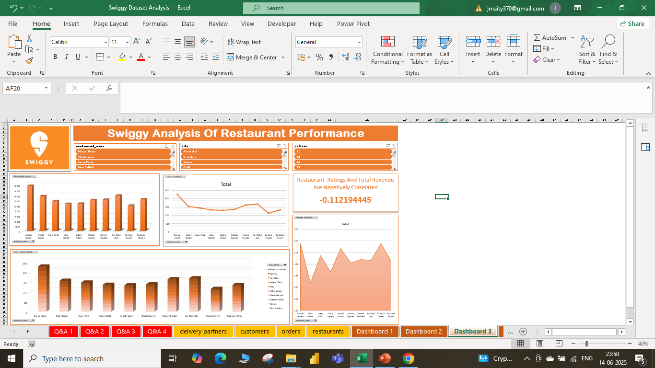

Slide 12
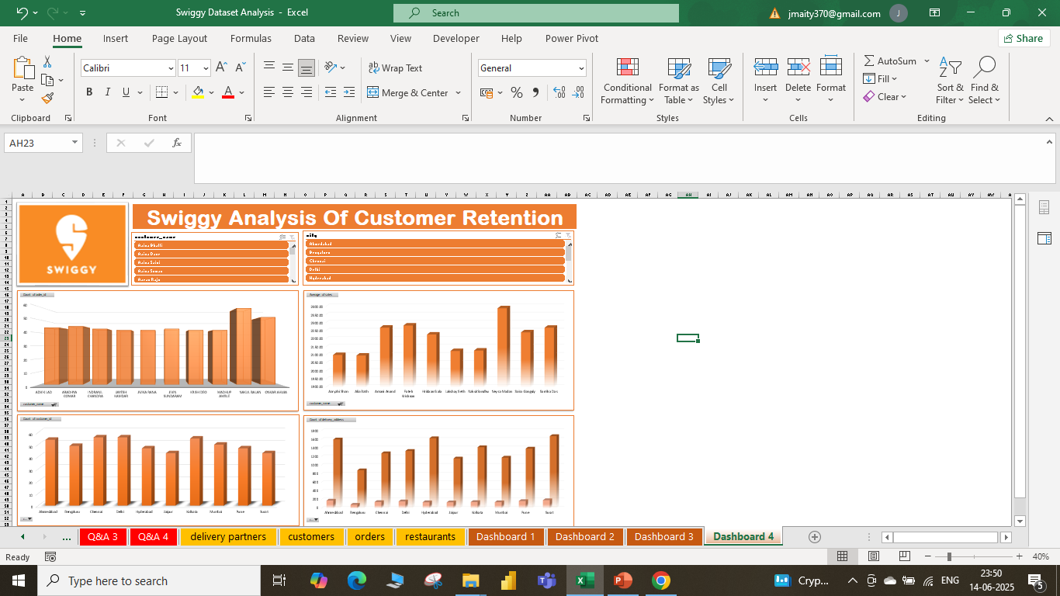

Slide 13
✅ Conclusion : This Swiggy dataset capstone project provides crucial insights for: Optimizing delivery partner assignment Enhancing, restaurant onboarding, strategies Designing, loyalty programs for high-value customers Predicting demand surges for efficient planning. 📌 Recommendations : Incentivize top-performing delivery partners. Partner more with high-rated and frequently ordered restaurants. Implement loyalty rewards for frequent and high-value customers. Use time-series forecasting to staff delivery teams better in peak months.

